Slide 1

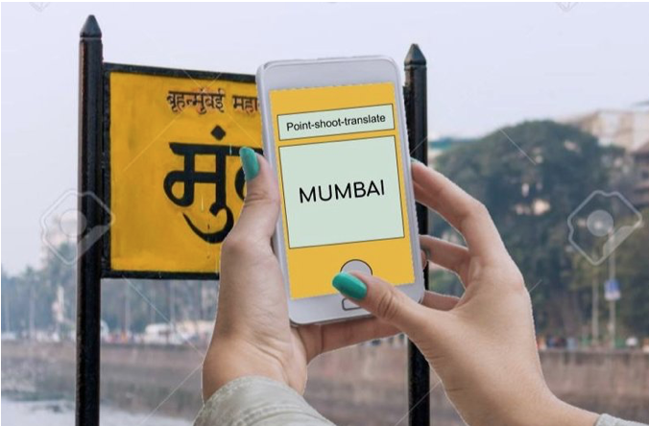
Signboard Transliteration for Tourists

Slide 2
Abstract :
There are 22 constitutionally recognized languages in India written in 13 different scripts. A traveller, on a business or pleasure trip, can often get confused by the various signboards written in an unfamiliar language in a new region. This often spoils the experience of visiting a new place and the traveller goes back with not-so-fond memories.
So, the goal of this project is to develop a model which transliterates the text written on a signboard from English to Hindi and vice versa.
Due to data availability , in this project we will design a system which only works for names (such as road names, city names, organization names, shop names and etc.) which typically contain 1-2 words and are rarely longer than 4-5 words.

Slide 3
Architectural Design:
For Signboard transliteration
Classification:
Text / No-Text
Detection :
Locating bounding box
Extraction:
Extracting text from image
Transliteration :
From English to Hindi and vice versa
Recognition :
Recognizing the text

Slide 4
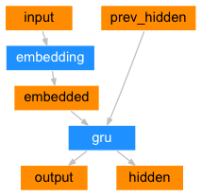
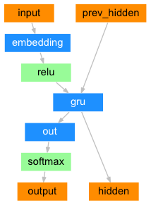
Transliteration Model’s Architectural Design:
For Signboard transliteration without attention:
Encoder
Decoder

Slide 5
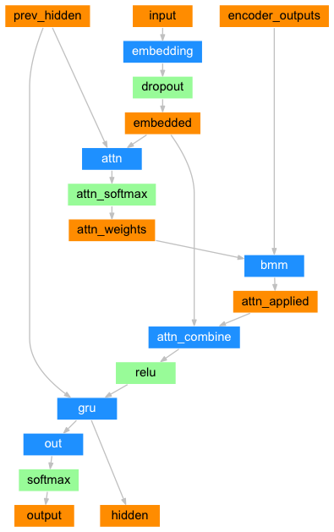
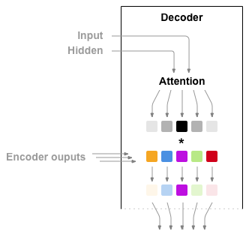
Transliteration Model’s Architectural Design:
For Signboard transliteration with attention:

Slide 6
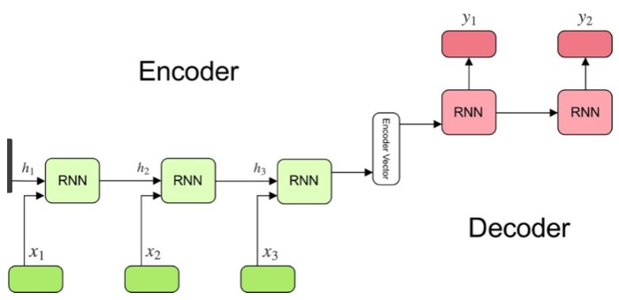
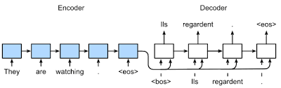
Transliteration Model’s Architectural Design:
Different ways of feed context vector to decoder:
Type - 1
Type - 2

Slide 7
Architectural Design:
For Signboard translation
Classification:
Text / No-Text
Detection :
Locating bounding box
Extraction:
Extracting text from image
Translation :
From Hindi to English and vice versa
Using Hugging Face
Recognition :
Recognizing the text

Slide 8
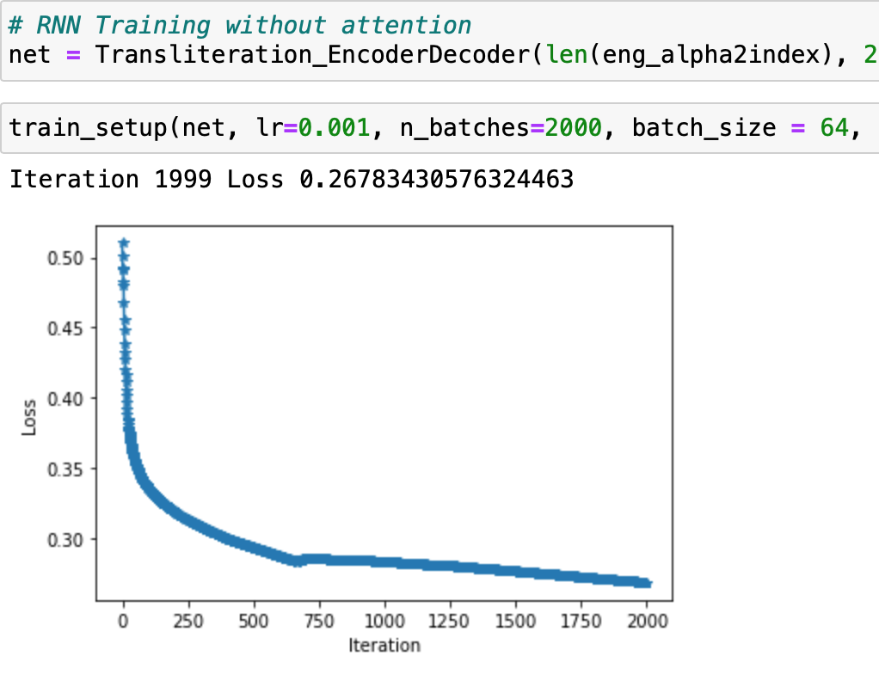
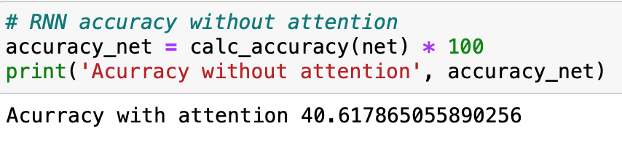
Results obtained: RNNs (w/o attn)

Slide 9
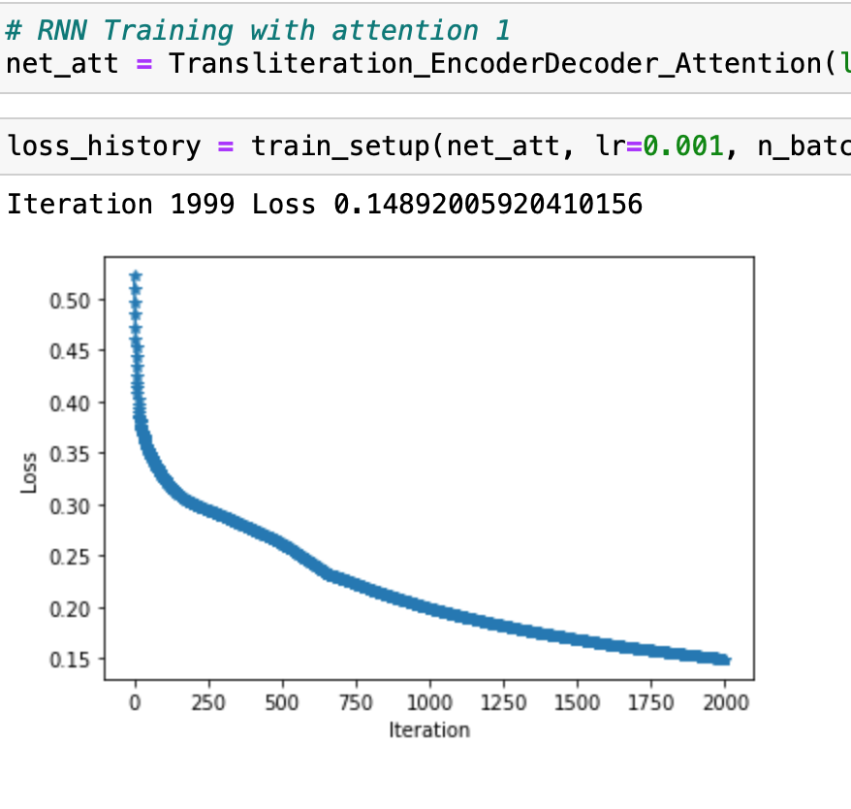
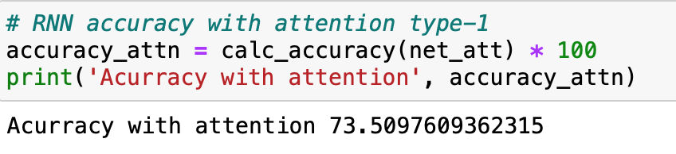
With attention type-1

Slide 10
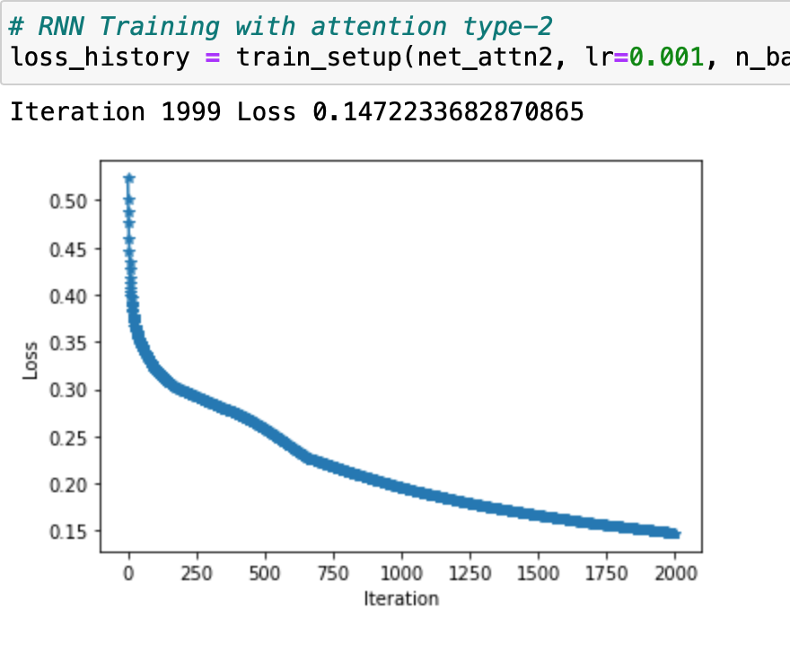
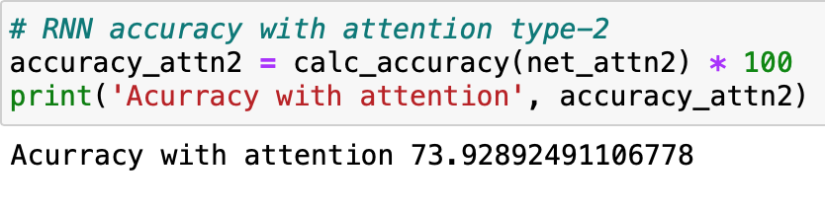
With attention type-2

Slide 11
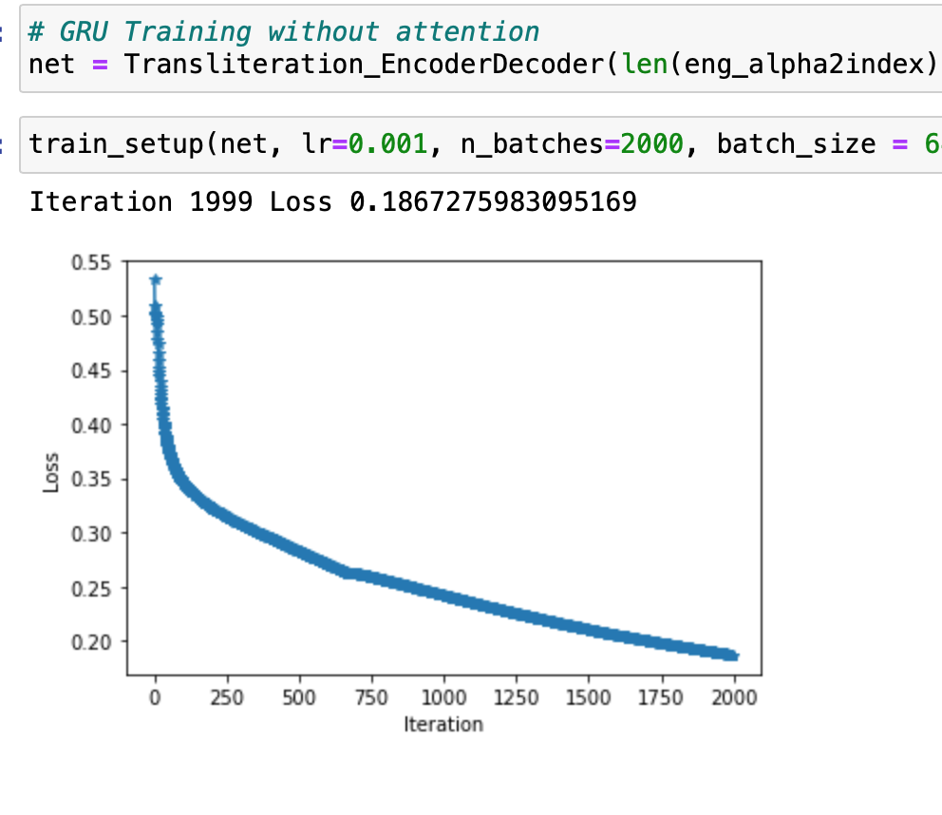
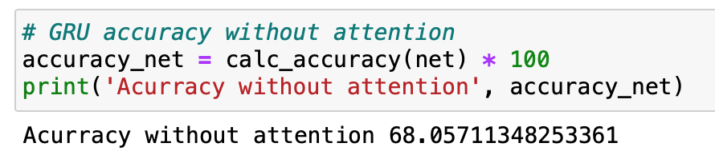
Results obtained: GRUs (w/o attn)

Slide 12
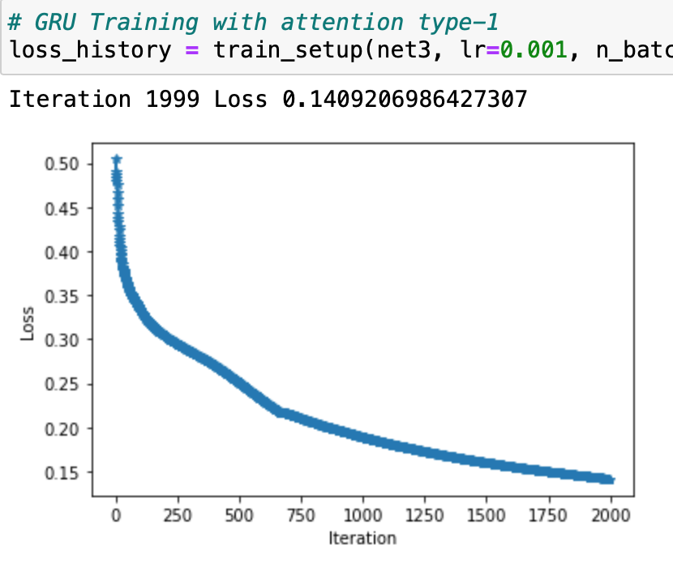
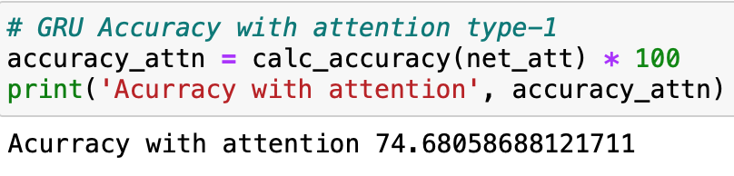
With attention type-1

Slide 13
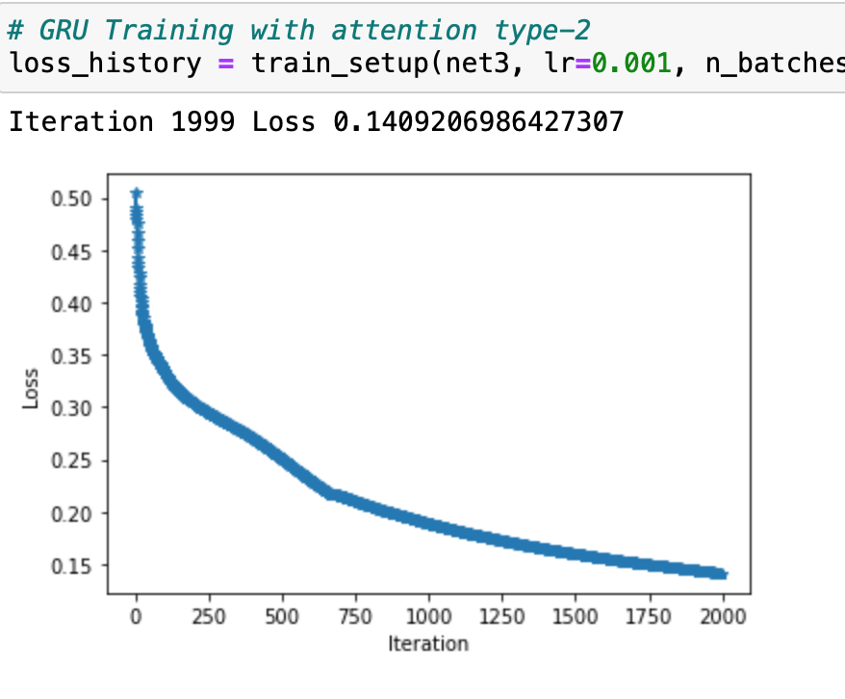
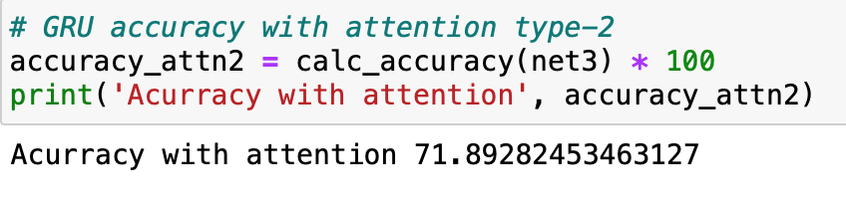
With attention type-2

Slide 14
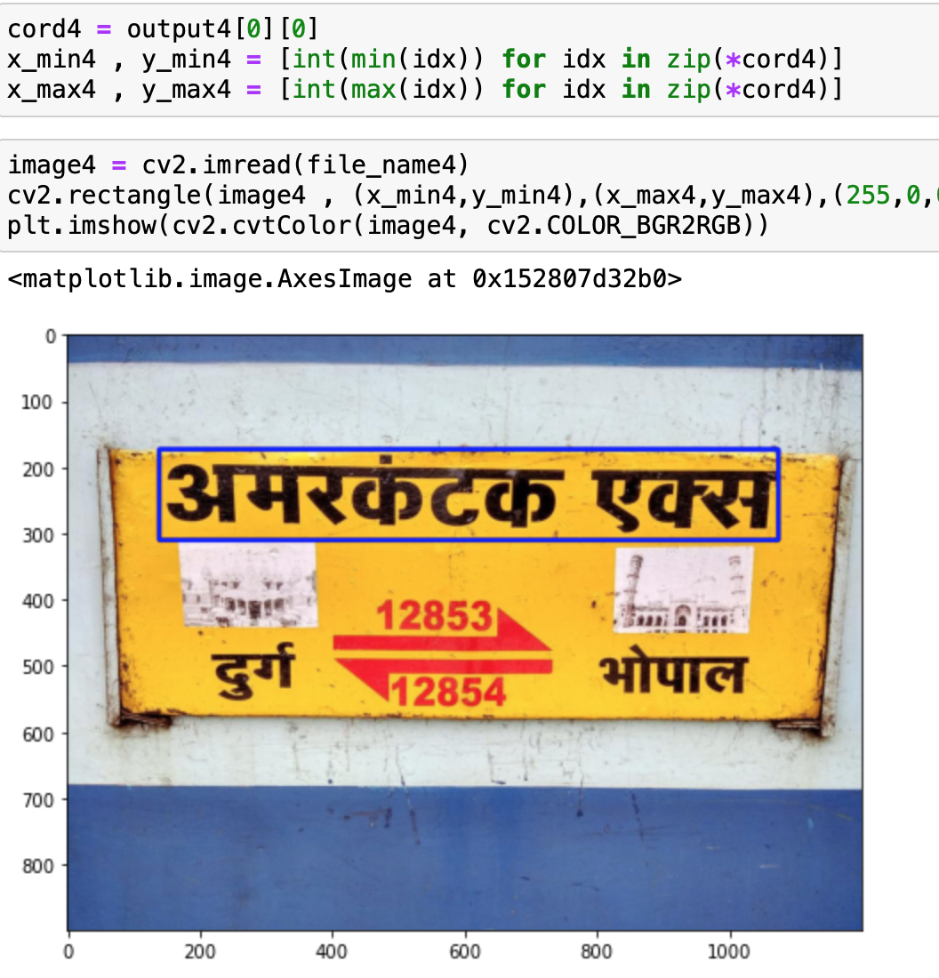
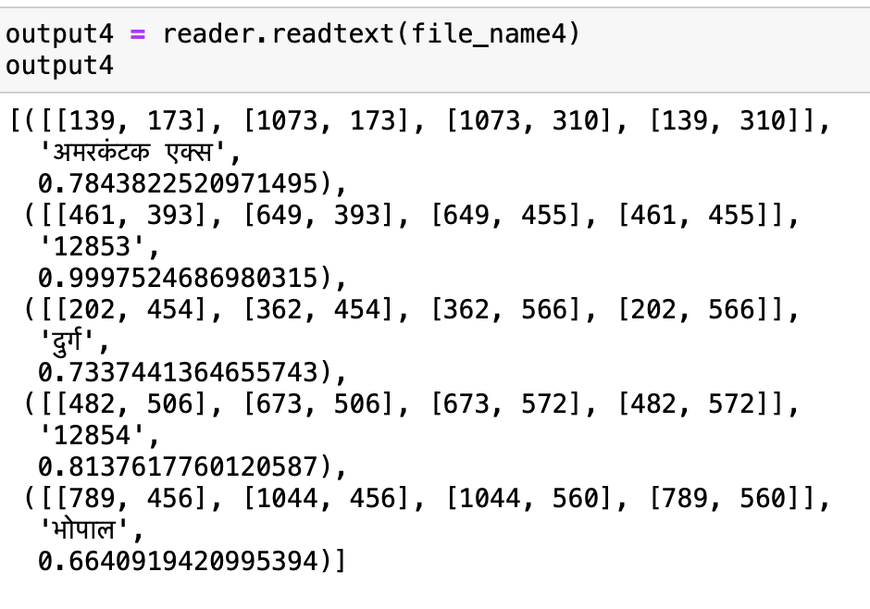
EasyOCR for Hindi Texts:

Slide 15
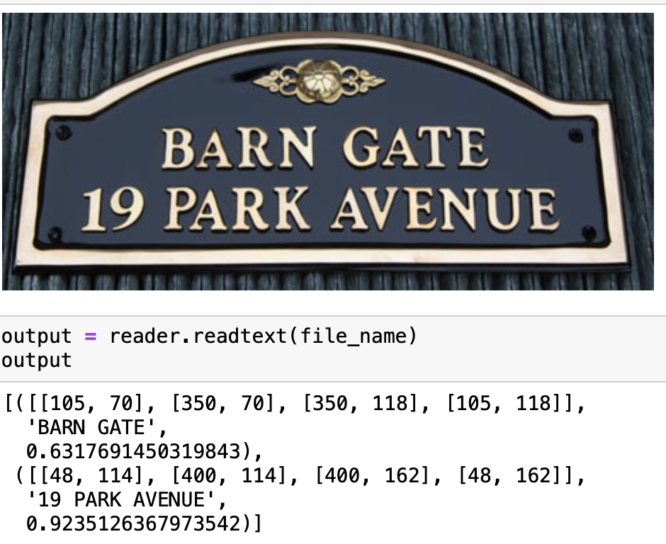
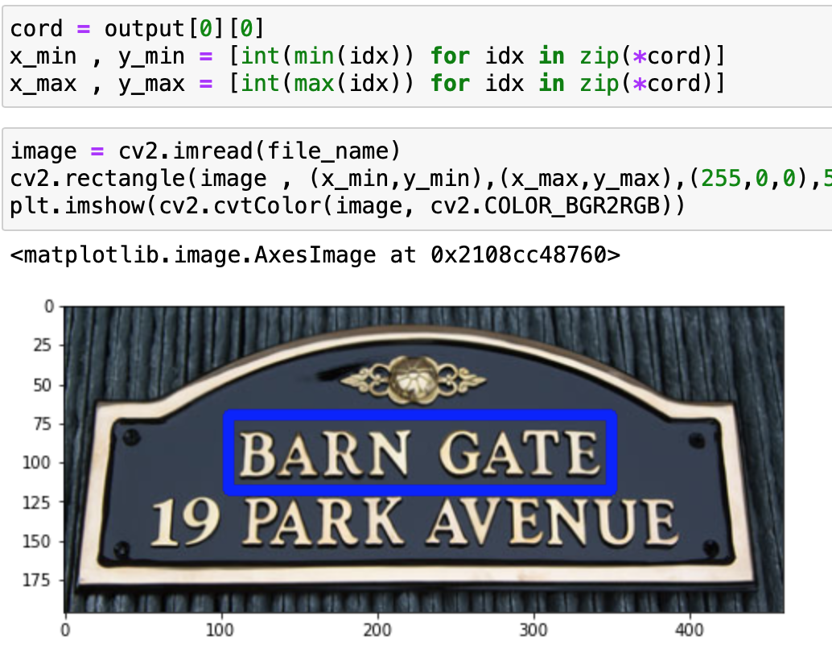
EasyOCR for English Texts:

Slide 16
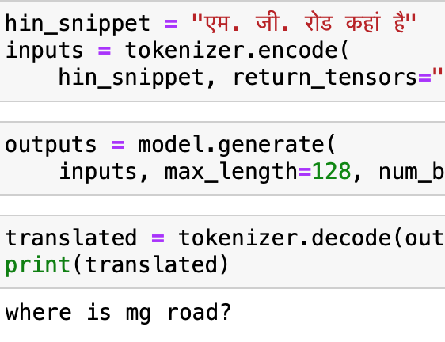
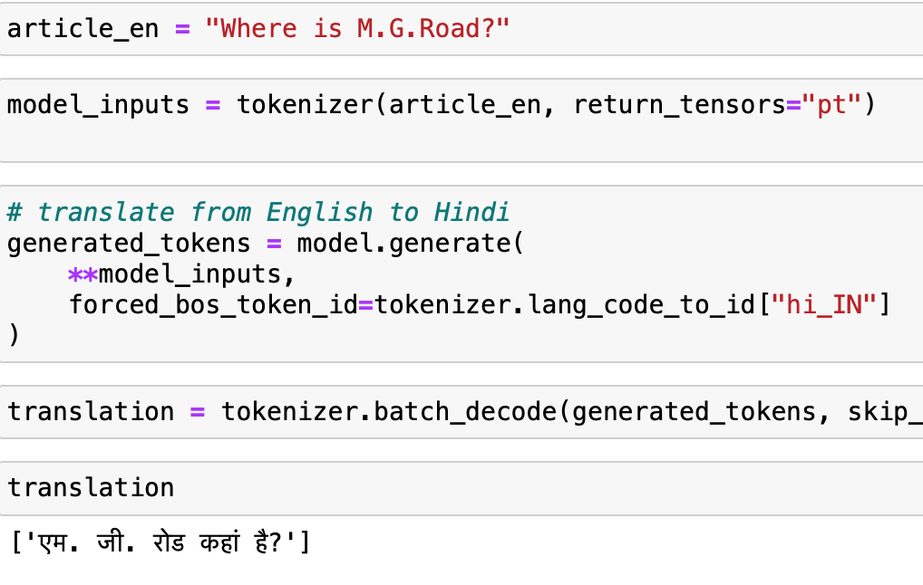
Translation using Hugging Face:

Slide 17
Performance results of Each model:
Models | Accuracy
Encoder-Decoder w/o attention using RNNs | 40.62
Encoder-Decoder with attention using RNNs (Type-1) | 73.51
Encoder-Decoder with attention using RNNs (Type-2) | 73.93
Encoder-Decoder w/o attention using GRUs | 68.06
Encoder-Decoder with attention using GRUs (Type-1) | 74.68
Encoder-Decoder with attention using GRUs (Type-2) | 71.89
Encoder-Decoder (GRUs) model with attention (Type-1) was our best performing model so we trained it with higher epochs and got the following results:
Best Model Trained with Higher Epochs than others | Accuracy
Encoder-Decoder w/o attention using GRUs (Type-1) | 80.38

Slide 18
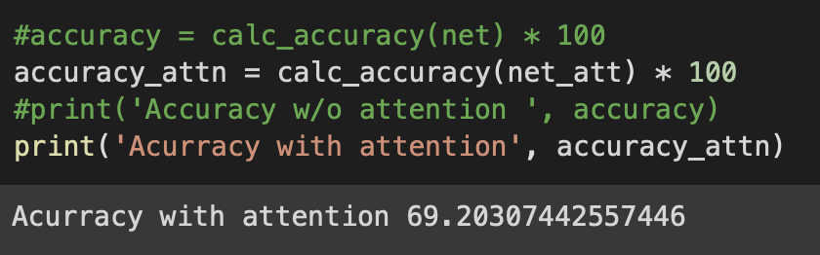
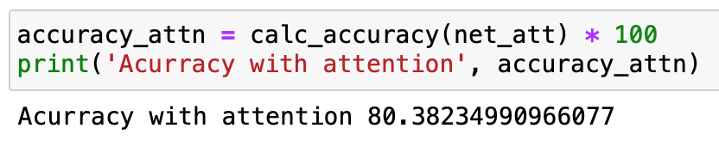
Experimental Results :
During First Phase:
During Second Phase:

Slide 19
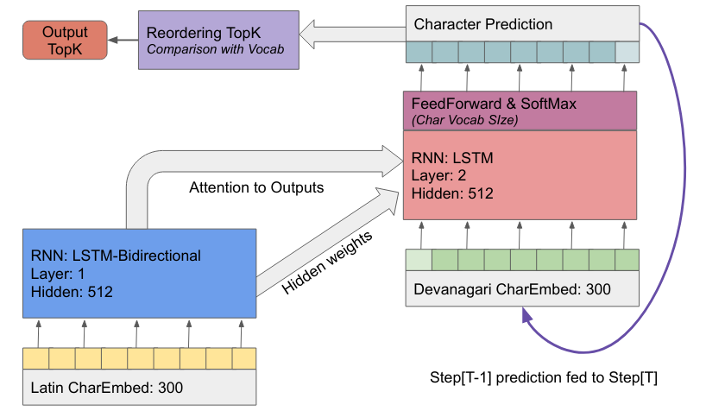
Deep Xlit::
Though our model was giving 80% accuracy on the test data, it didn’t perform well in reality.
So, I tried Deep Xlit model which is open-source transliteration engine for Indian Languages.

Slide 20
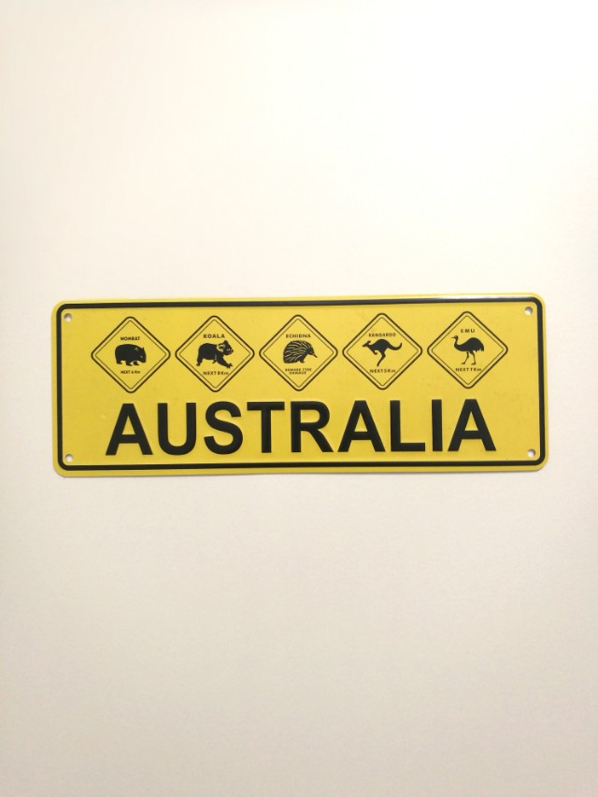
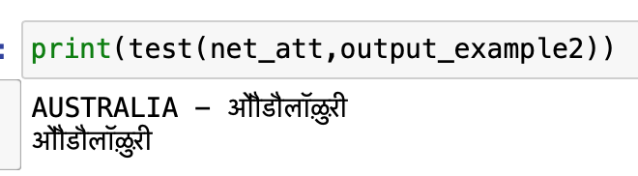
Output from our Transliteration model : En-Hi

Slide 21

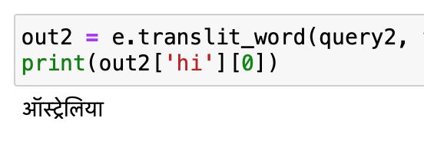
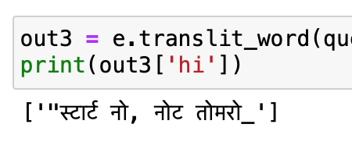
Output from Transliteration model : Deep-Xlit

Slide 22
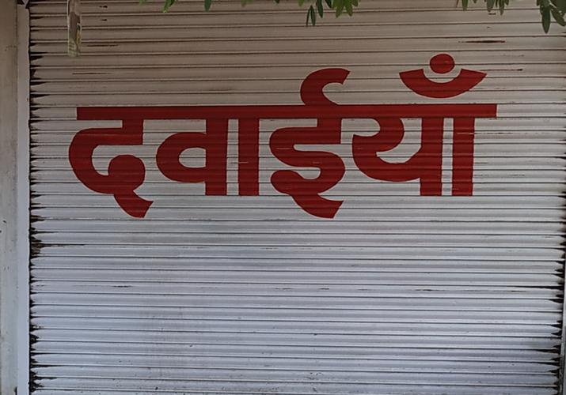
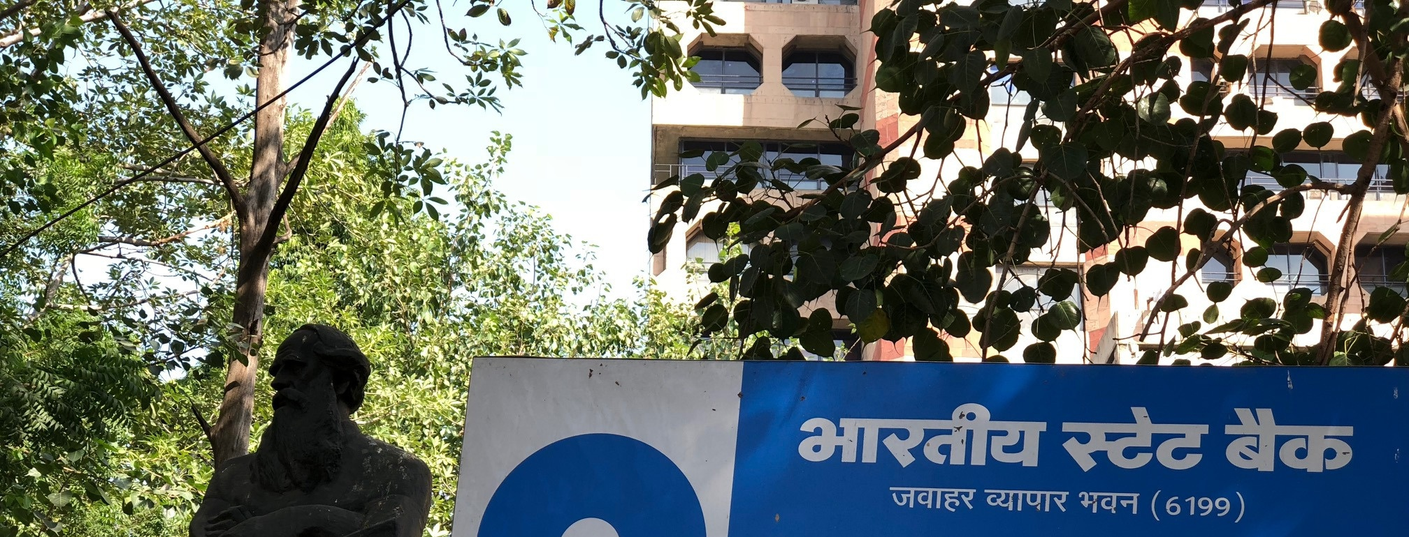
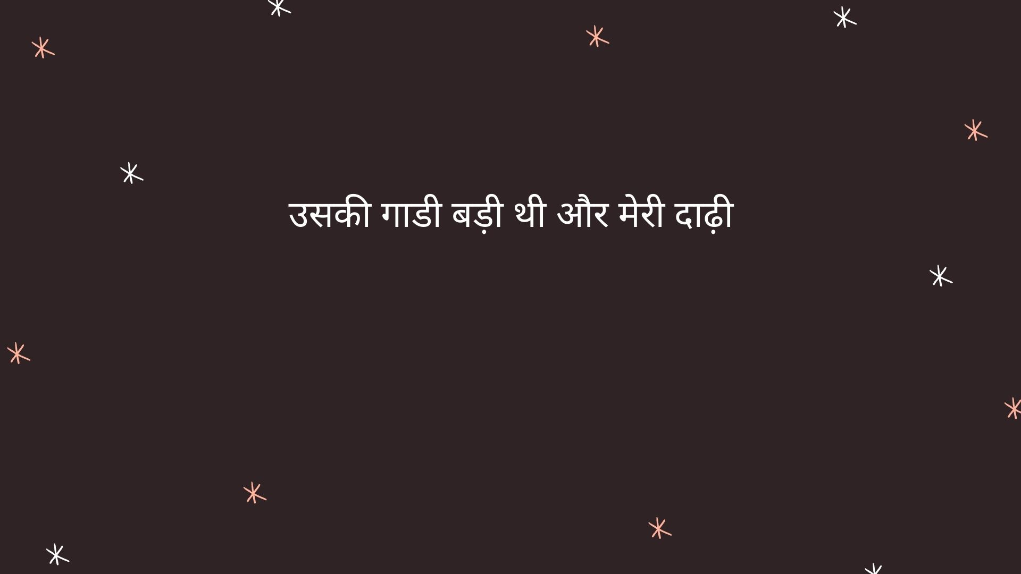
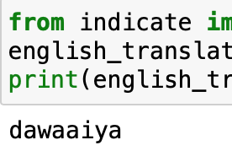
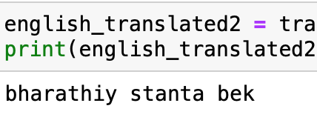
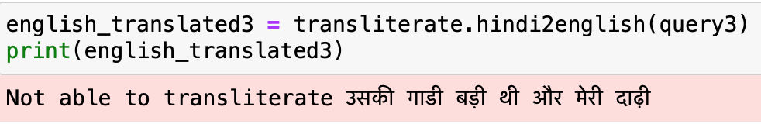
Output from our Transliteration model : Hi-En
Using Indicate Python Library

Slide 23
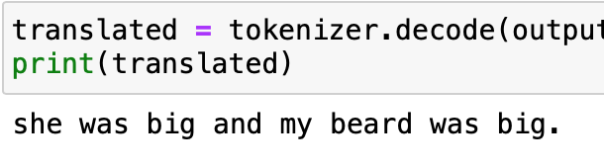
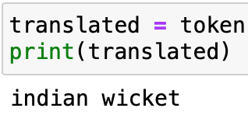
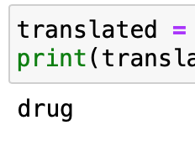
Output from Translation model : Hi-En

Slide 24
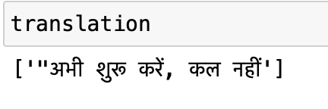
Output from Translation model : En-Hi

Slide 25
Research Papers used for Reference :
This project topic idea was posted as a challenge by AI4BHARAT.
1. R. Rahul, S. Bhaskaran, J. Amudha and D. Gupta, "Multilingual Text Detection and Identification from Indian Signage Boards," 2018 International Conference on Advances in Computing, Communications and Informatics (ICACCI), 2018, pp. 1120-1125, doi: 10.1109/ICACCI.2018.8554778.
2. Kavati, Ilaiah & Kumar, G & Kesagani, Sarika & Rao, K. (2017). Signboard Text Translator: A Guide to Tourist. (IJECE). 7. 2496. 10.11591/ijece.v7i5.pp2496-2501. Bhattarai, B., Granmo, O.C. and Jiao, L., 2021.
3. Mathew, M., Jain, M., & Jawahar, C. V. (2017, November). Benchmarking scene text recognition in Devanagari, Telugu and Malayalam. In 2017 14th IAPR International Conference on Document Analysis and Recognition (ICDAR) (Vol. 7, pp. 42-46). IEEE.
4. Rosca, M., & Breuel, T. (2016). Sequence-to-sequence neural network models for transliteration. arXiv preprint arXiv:1610.09565 .
5. Wu, Y., Schuster, M., Chen, Z., Le, Q. V., Norouzi, M., Macherey, W., … & Klingner, J. (2016). Google’s neural machine translation system: Bridging the gap between human and machine translation. arXiv preprint arXiv:1609.08144 .

Slide 26

THANK YOU !

